Slide 1
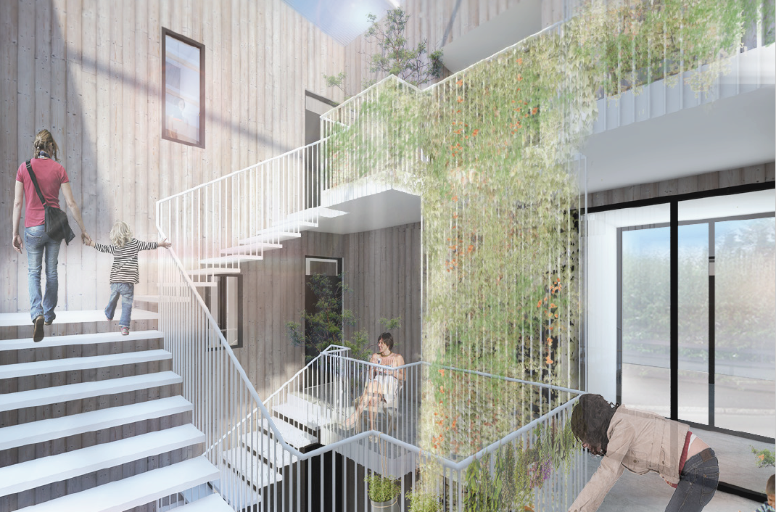

Slide 2
Bjarg
Bjarg is non-profit apartment rental company that operates in compliance with Act on General apartments from 2016. The company was founded in í September 2016 by Icelandic Confederation of Labour (ASÍ) and Federation of State and Municipal Employees (BSRB). Bjarg will offer long-term rental apartments for people with low salaries.
Design of first houses is in progress and construction work is planned to start next autumn.
Bjarg has made contracts with Reykjavík and Hafnarfjörður for 1150 apartments in next four years.
Projects in other municipality's are in preparation.

Slide 3
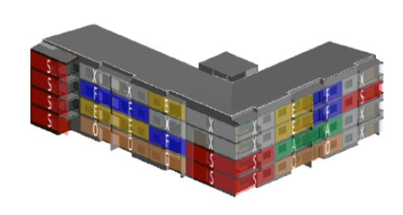
Theme - Reykjavíkurhús
The new Reykjavik houses are affordable rental apartments planned to be build in the coming years for individuals and families. In each house will focus on the diversity of individuals and families.
We seek to pass new and creative ways to design with the aim to create quality living and the objective of strengthening the social capital of the tenants. It will be done, among other things with exploring the possibility of sharing common spaces and transport.
Affordable houses - cooperation with the municipality
- Fixed land prices.
- Take part in creating of land usage plans

Slide 4
Example - indoor car park, effect on rent
Rental of 45 sqm. flat increases roughly 22% adding a indoor car park
Rental of 85 sqm. flat increases roughly 15% adding a indoor car park

Slide 5
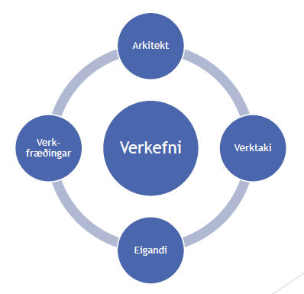
Design
The design process is a collaboration between architect, engineer, contractor and owner (partnering). Parties work closely together during the design phase with the goal to achieve efficiency in the construction, operation and durability.
Cost based design. The houses have to be within a predetermined maximum construction costs. Experience is key factor in the selection of partners. Variety of construction techniques will be examined.
BIM data model
BIM data model will be built in the design process and will remain involved in the management of the property. Developers provide information about building parts and materials used which will be registered in the model.

Slide 6
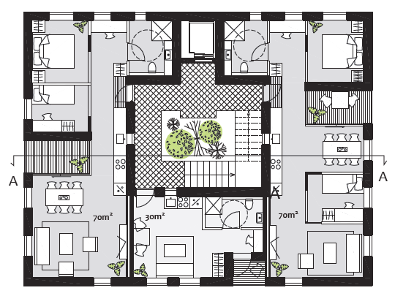
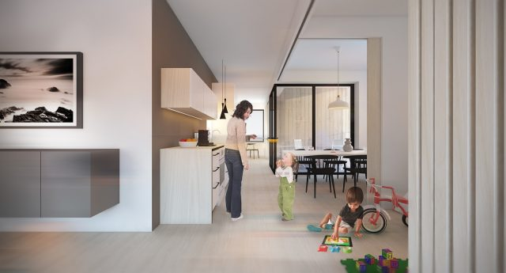
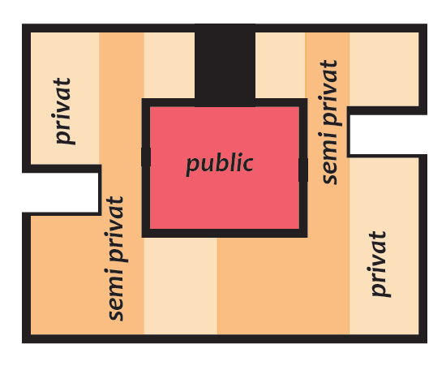
Example project - Skarðshlíð Hafnarfirði.

Slide 7
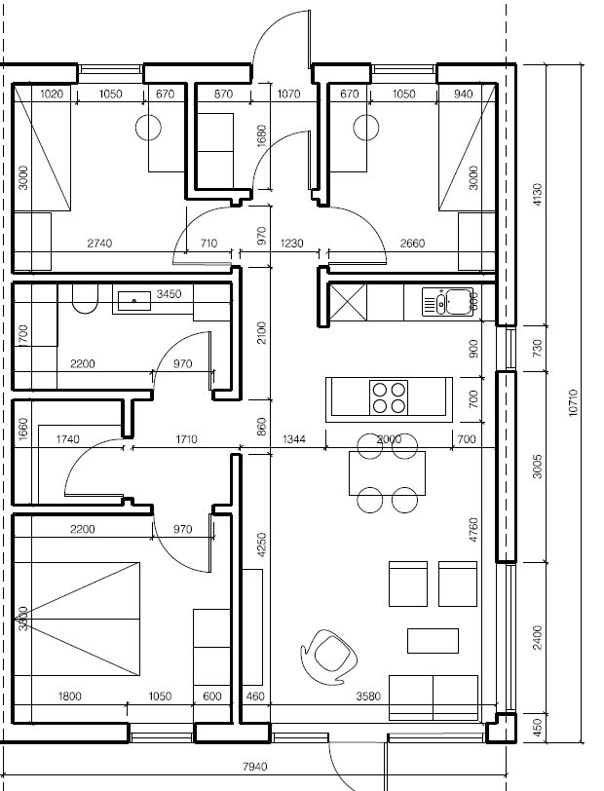
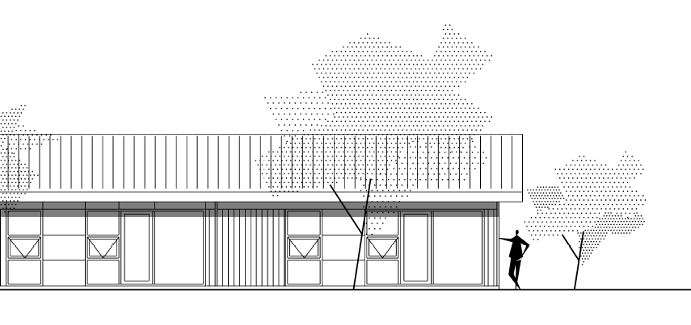
Example project - Simple single-family house
Construction of 85 sqm single family houses that may be suitable in smaller municipalities.
Volume purchases if built in many locations.

Slide 8
How can we simplify / increased mass-produced apartments / pave the way for mass production of houses?
There is long tradition in Iceland of building a concrete houses
Architects, engineers and contractors have knowledge an tools to build in that way and are reluctant to take a new approach.
Marketing for prefabricated houses has to be aimed at those parties.
We have had many salesmen's offering new solutions but too many have just found company on the internet and can not offer reliable solution.
- Manufactures have to use direct marketing, cut out the middle man.
- Manufactures have to partner with contractors
- Manufactures have to look into investing in the building of the first houses.

Slide 9
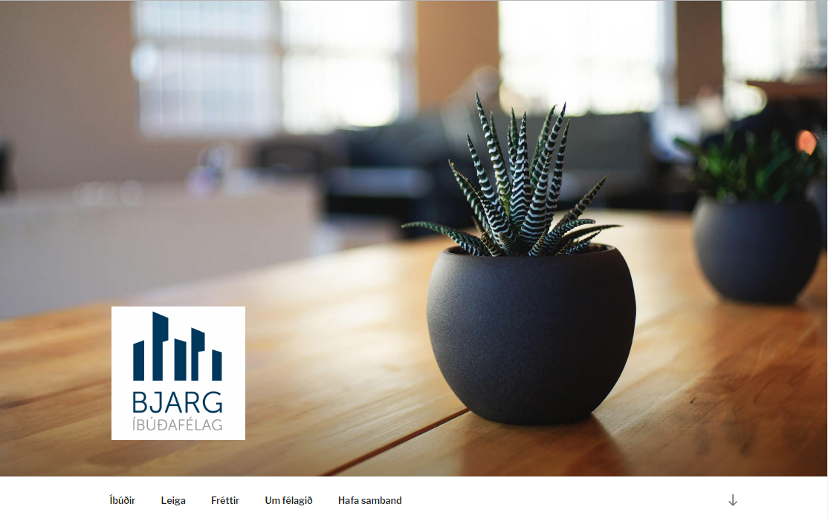
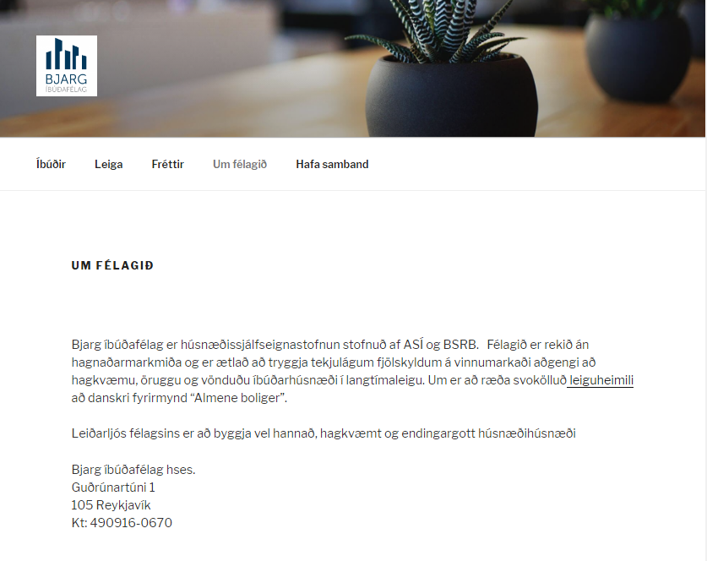
Web
www.bjargibudafelag.is

